Slide 1
Linea Detection of Europa Using ML Midway Report
Pradeep Kumar Baisakh & Anshuman Panda
Mentors: Dr. Guneshwar Thangjam, Dr. Subhankar Mishra

Slide 2
Project analysis slide 2
Introduction:
This presentation explores the application of machine learning (ML) techniques for detecting Lineas on Europa's surface. Leveraging ML algorithms, we aim to automate the segmentation process, contributing to our understanding of Europa's geophysical features and potentially uncovering valuable insights into its composition.
Midway Goals :
Literature review on topic and image segmentation algorithms
Implementing baseline algorithms
Attempt to acquire better dataset
Work on a new model
Goals Achieved :
Literature review
Implementing baseline algorithms
Attempted to implement a new model (KNN based)

Slide 3
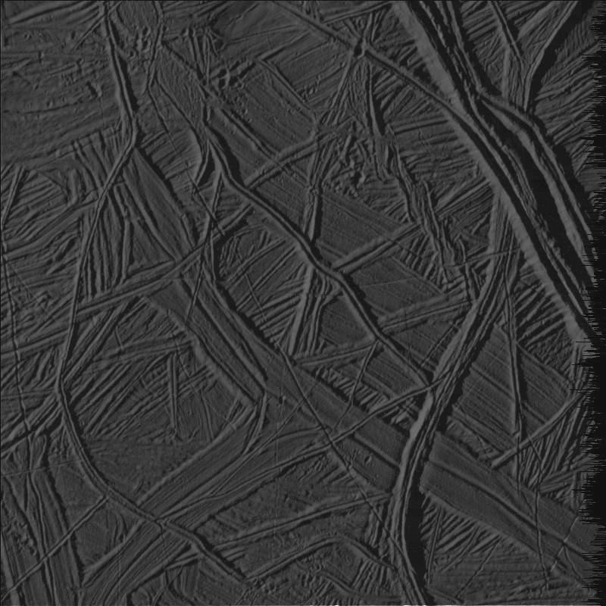
Project analysis slide 3
Dataset :
The data set consists of images were sourced from Galileo's Solid State Imaging instrument and are publicly accessible through NASA via PDS-atlas. It has seven 800 × 800 size images which were manually annotated before.
7 images of size
800 × 800
Split each one into four quadrants
28 images of size
400 × 400
Feature Extraction
Original image
Masked image

Slide 4

Project analysis slide 4
Feature Extraction
The original gray scale images were flattened, i.e. the 2D image matrix is transformed into a 1D array, where each element represents a pixel intensity value. Using various image processing techniques like gabor, canny, sobel. Feature values were extracted and using gaussian, median and variance filters the data set was normalized and stored in a panda dataframe. Where each row corresponds to an image and each coloumn a feature.
The data frame we got, had 4,160,000crows × 51 columns, The dimension of the dataset was reduced to contain only top 20 features to reduce the computational time and power.
Customer Objectives
Resources

Slide 5
Project analysis slide 5
Labels:
Label Preparation was done by creating masks corresponding to lineae and converting them to binary format (0 for no lineae, 1 for lineae). Also Binary masks were flattened for training. Masks are just the original images but each pixel was transformed based on, if it has a linea change it to 255 on grayscale(I,e. white) and 0 on gray scale (i.e. black) if it has no linea.

Slide 6
Model:
We tried to rebuild the “Random forest” model to learn about the process of image processing, data imbalance handling, training and testing of the model.
In the dataset, the Lineas class, representing the minority, is significantly underrepresented in the dataset. So, even if the model predominantly predicts pixels to belong to the majority class, it can achieve a high accuracy. To address this data imbalance issue, Random Under Sampling (RUS), involving the random removal of majority class points, and Synthetic Minority Over-sampling Technique (SMOTE), which involves generating synthetic minority class datapoints, were used.
The data set was split to 70% and 30% for training and testing respectively.

Slide 7
Model Evaluation:
The model was evaluated with pixel accuracy, where the model gets a score of 1 for each correct pixel classification (linea or surface), and 0 for misclassifications, then the accuracy is the total sum of these values (1 or 0) over total number of pixels. IoU(Intersection over Union) value is the intersection of the predicted image and the mask divided by the unionof the predicted image and the mask. Mean Intersection over Union (mIoU) calculates the average IoU across multiple classes or instances.
Data Type | mIoU(%) | IoU(%) | Pixel Accuracy(%)
Training | 69.04 | 56.27 | 85.26
Testing | 47.13 | 9.29 | 38.12

Slide 8
Conclusion:
In conclusion, by trying to rebuild this machine learning model for detecting Lineas on Europa's surface helped us in learning the process of data processing, feature extraction, model training and about model performances. By our method of employing feature extraction techniques and training the model with Random Forest, the achieved accuracies show that this model now, is not practically applicable for scientific use. The evaluation metrics, including pixel accuracy and IoU, demonstrate the model's effectiveness in detecting Lineas. We are planning to build other models using different ML algorithms or some hybrid algorithms which could give us better predictions while detecting the lineas, paving the way for deeper insights into Europa's intriguing geology.
References:
[1] P. Sathya and M. Lakshmanan, Classification and segmentation in satellite imagery using back propagation algorithm of ann and k-means algorithm, International Journal of Machine Learning and Computing , 422 (2011). [2] N. Plath, M. Toussaint, and S. Nakajima, Multi-class image segmentation using conditional random fields and global classification, in Proceedings of the 26th Annual International Conference on Machine Learning, ICML ’09 (Association for Computing Machinery, New York, NY, USA, 2009) p. 817–824. [3] D. Hartmann, D. M ̈uller, I. Soto-Rey, and F. Kramer, Assessing the role of random forests in medical image segmentation (2021), arXiv:2103.16492 [eess.IV]. [4] G. Cao, S. Wang, B. Wei, Y. Yin, and G. Yang, A hybrid cnn-rf method for electron microscopy images segmentation, Journal of Biomimetics, Biomaterials, and Tissue Engineering 18 (2013). [5] N. P. Das, R. G. Nazareth, S. Mishra, and G. S. Thangjam, Automated Detection of Lineaments on the Surface of Europa Using Machine Learning, in 53rd Lunar and Planetary Science Conference, LPI Contributions, Vol. 2678 (2022) p. 2709

Slide 9
Thank You

